Slide 1
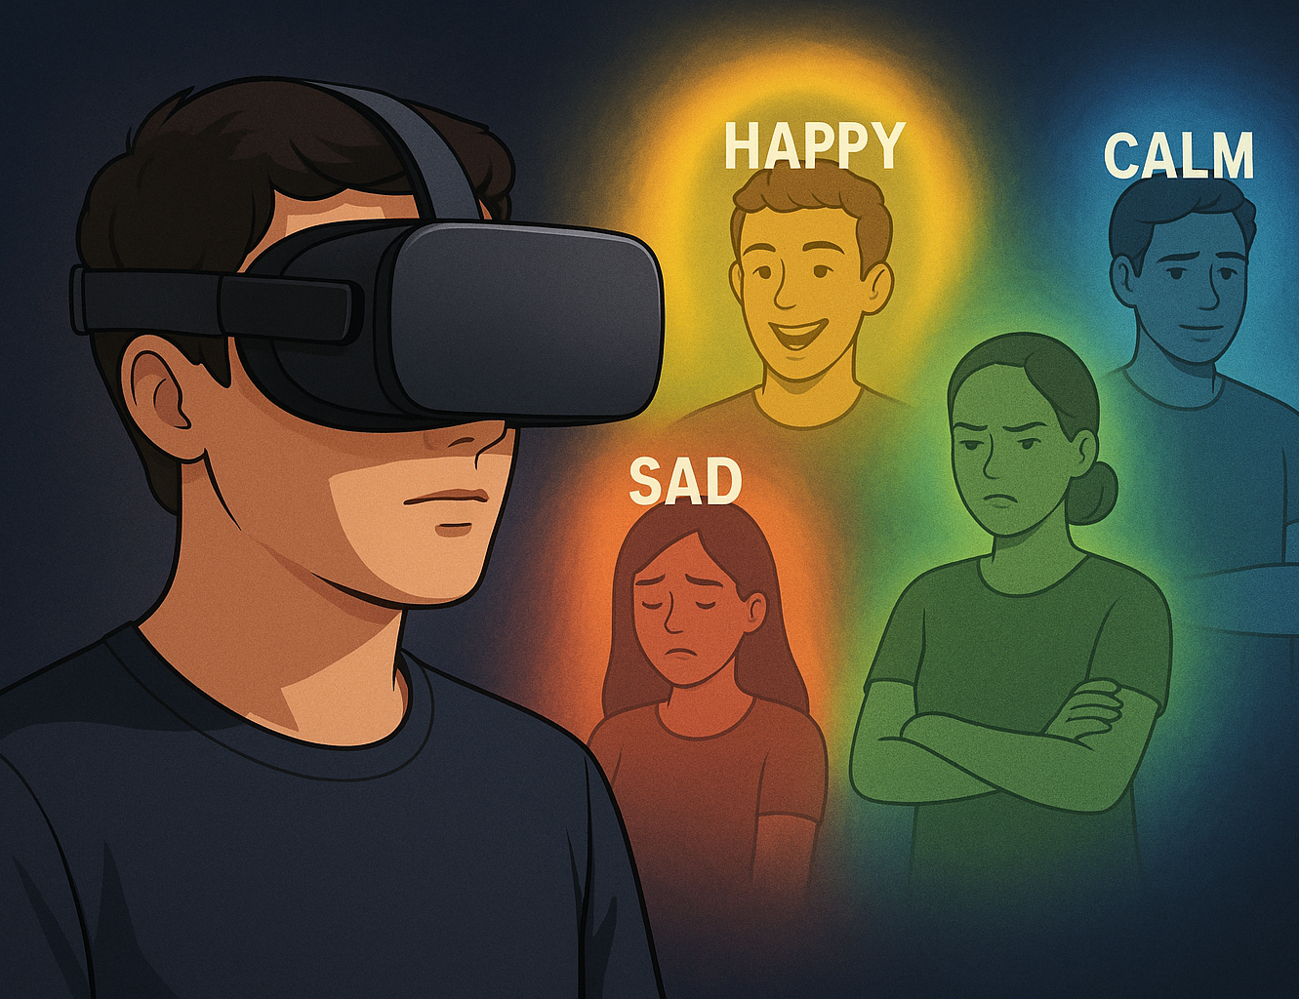
VibeSniffa: Emotion Reconigtion & Visualization Using Oculus Quest 3
By: Hengyu Li, Matteo Sakr, Yoonseo Chung, Yusuf Hussein, Yousef Masad

Slide 2
Overview
• Motivation – Why did we choose to work on this problem?
• Approach – How did we design and build our solution?
• Results & Demo – What does the system do, and how well does it work?
• Limitations – What challenges or constraints did we face?
• Conclusion – What did we learn from building this project?

Slide 3
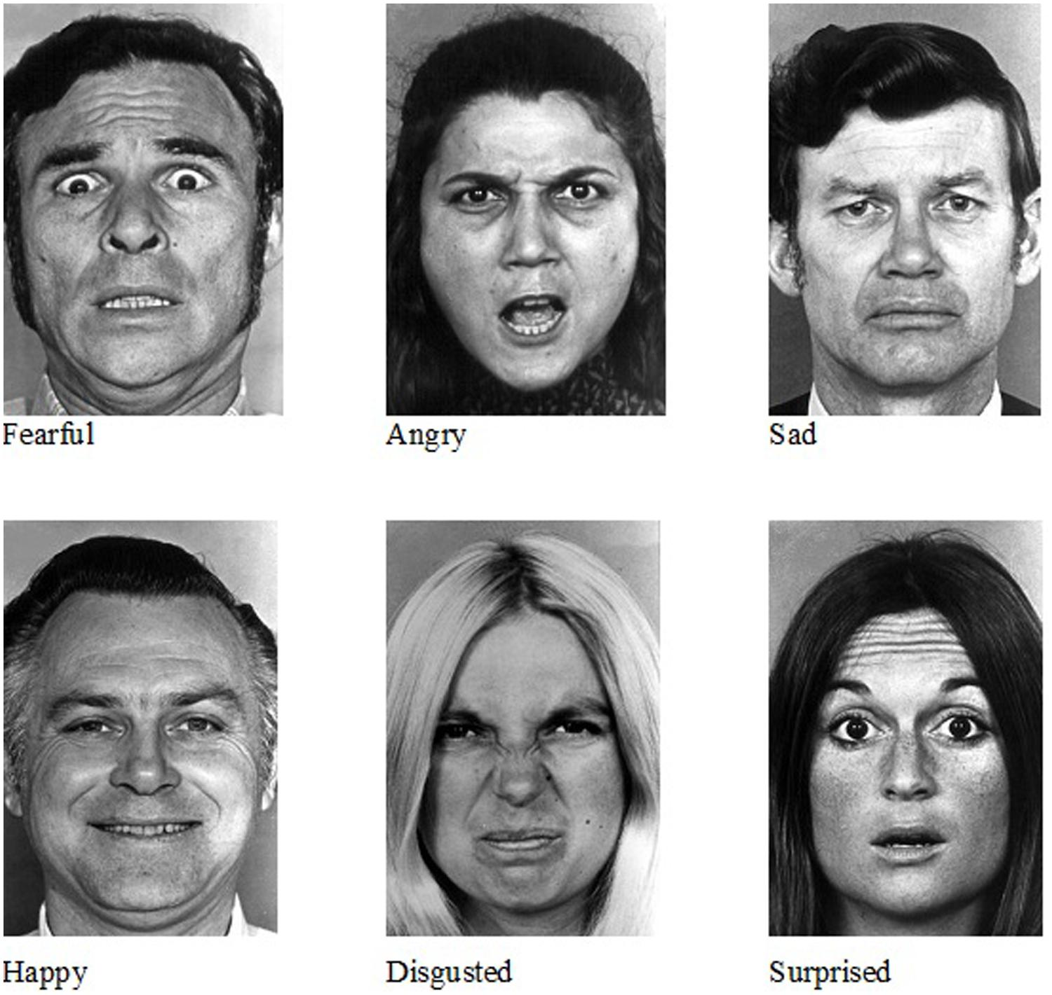
Motivation
Emotional Awareness is Hard for Many
Many people struggle to interpret others’ emotions accurately, such as people that suffers from:
Autism Spectrum Disorder (ASD)
Neurological conditions like alexithymia
Others may simply feel awkward in social settings and benefit from gentle guidance.
Our project acts like augmented social coach, helping users learn to read emotions over time.
Notes:
One of the key motivations for our project comes from the fact that emotional awareness doesn't come easily to everyone
There are many individuals who struggle to interpret facial expressions, I can definitnetly relate myself where I have wrongly interpreted people’s facial expressions which led to awkward situation,
But there are also individuals who suffers frim autism spectrum disorder or people with neurological condition like alexithmia who is emotionally blind.
But it’s not just medical — even in everyday life, many people feel awkward in social settings, unsure how to read subtle emotional cues from others.
Our project acts like a kind of augmented emotional coach — giving users real-time hints about how others are feeling. Over time, this can help people learn to recognize emotions more effectively, and become more confident in social interaction.

Slide 4
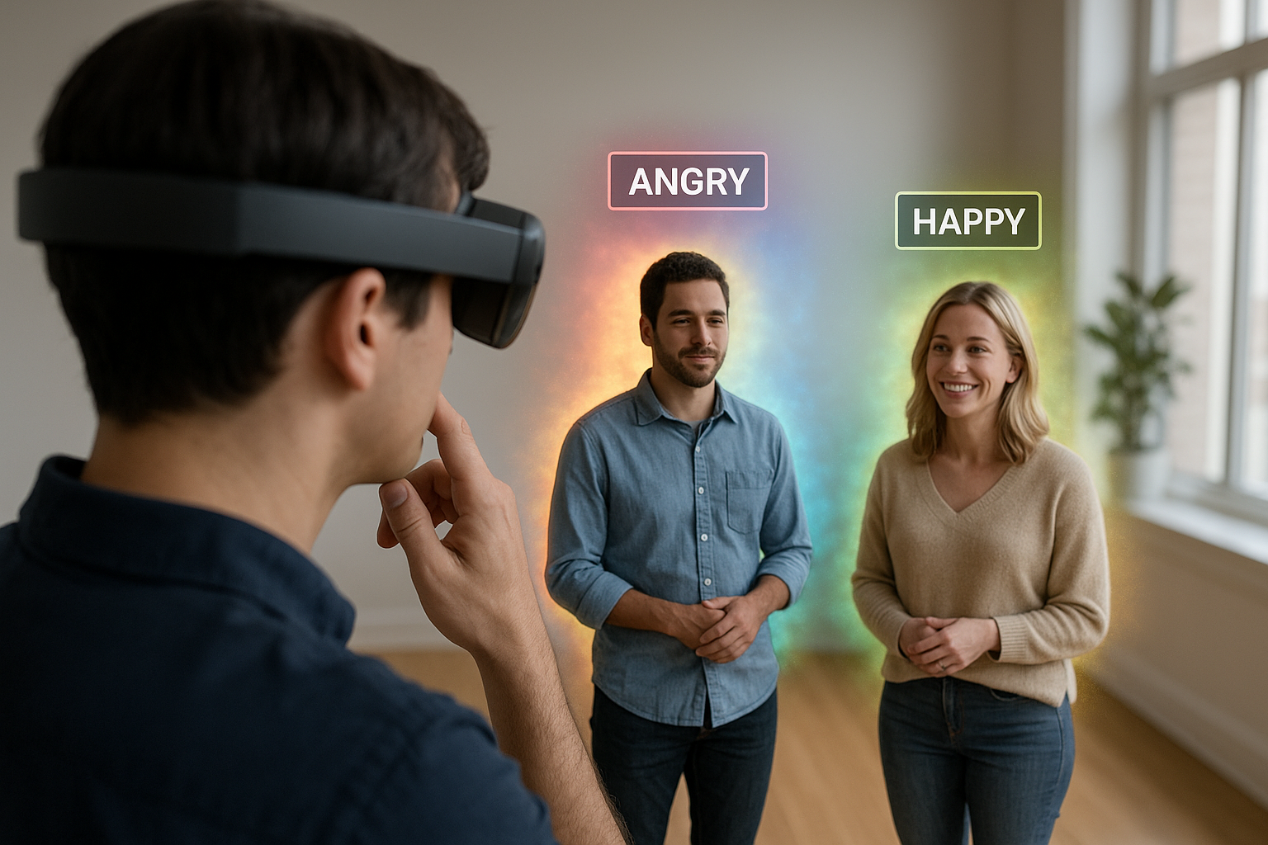
Motivation
2. Bringing Emotional Intelligence into Augmented Reality
AR is usually used for navigation, information, or entertainment — but very rarely for emotional context.
The ability to visualize how people are feeling in real time.
This could lead to more empathetic interactions and more socially aware AR applications.
Notes:
Another key motivation we had was found during the brainstorm stage of our project, where we found wether in virual, augmented or mixed reality, there is no emotional aspect to the application used nowadays. For example AR is usually used for navigation, information, or entermainment, rarely used in a emotional context.
So, we dediced to visualize how people are feeling in real time to make AR application, and interactions more empathetic.
Now let’s about the approach we took to put this system together.

Slide 5
Approach
Inference Service
Built as a FastAPI python service to bridge model inference to REST API queried by the Headset
Face Detection:
Using a pretrained YOLOv8 model fine tuned for face detection
Emotion Classification:
Pretrained Vision Transformer Classifier is used to classify faces into a set of the most common 7 emotions
The model can also be queried for its softmaxed outputs, to know the distribution over emotions
Natural Language Inference:
Activations are passed to OpenAI’s Responses API with a clear system prompt, generating a humorous description based on the activations given.
VR Application
Capturing frames periodically and processing user input
Bounding boxes, emotion colors, and LLM description are visualized in real-time on target positions

Slide 6
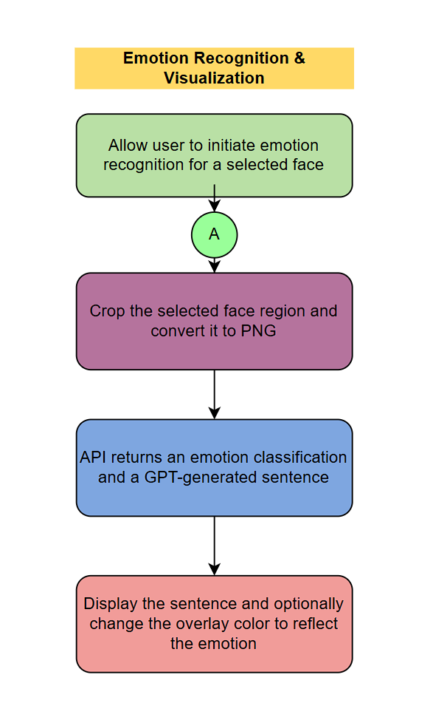
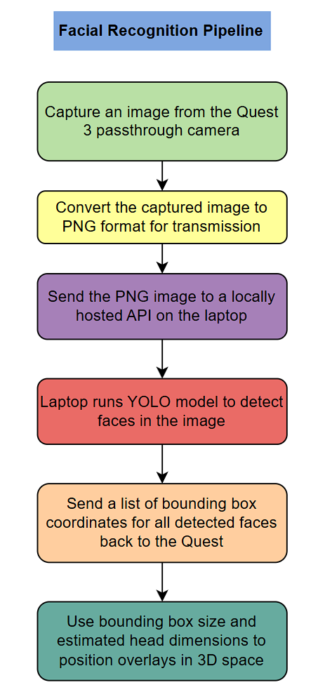
Approach
Multi-Stage Pipeline
All Sub-Systems are Configurable and Adjustable

Slide 7
Result & Demo

Slide 8
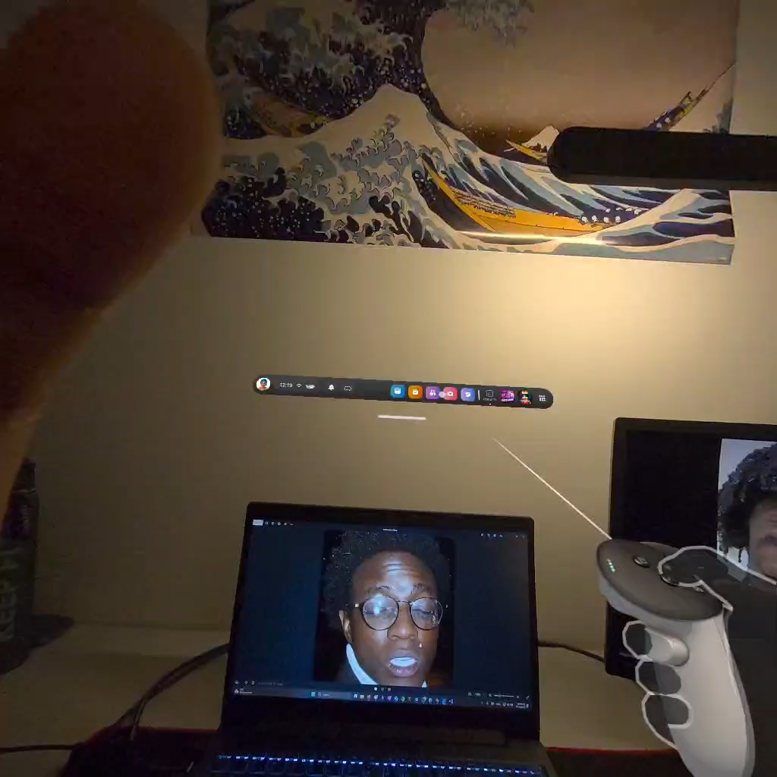

Slide 9

Limitation of our project: Problems
Real Time Performance Issues:
Latching Boxes
High Latency
Glitches
Model Inaccuracies:
Inconsistent Model Outputs
Face Placement Issues

Slide 10
Limitation of our project: Solutions
Real Time Performance Issues:
Correct for 1 Camera Usage
Improve Models Used or Smooth Outputs
Deploy AI models on device
Higher Frequency Processing
Model Inaccuracies
Box Movement Smoothing
Hiding Boxes and Only Showing Text Above Screen

Slide 11
Conclusion
Successfully created a real-time emotion detection pipeline in MR using face detection (YOLO), ML emotion classification, and GPT-based interpretation.
Impact:
Adds a new layer of emotional intelligence to immersive platforms.
Allows for another dimension of social interaction.
Can be used in medical & psychological applications
Future Work:
Explore direct emotional response adaptation in the MR environment (e.g., change scene based on emotion).
Optimize latency and on-device processing for scalability.

Slide 12
Thank You for listening !
Q&A Time !

